Slide 1
程序设计原理
C++字符串
任课教师： 喻 梅
于瑞国
王建荣
李雪威
赵满坤

Slide 2
Why do we need strings?
Motivation
In our daily programs, we often need to deal with textual information — names, addresses, messages, book titles, or any other words and sentences.
Numbers (int, double) cannot represent text, so we need a special data type to store and process a sequence of characters. That data type is string.
#include <iostream>
#include <string>
using namespace std;
int main() {
string name = "Alice";
cout << "Hello, " << name << "!" << endl;
return 0;
}

Slide 3
Declaring and Initializing Strings
Strings can be initialized (assigned a value) in several ways:
string s1 = "Hello"; // direct initialization
string s2("World"); // constructor style
string s3; // empty string
s3 = "C++"; // assignment after declaration
#include <iostream>
#include <string>
using namespace std;
int main() {
string greeting = "Welcome to C++!";
cout << greeting << endl;
return 0;
}

Slide 4
Reading and Printing Strings
Use cin >> to read an item into a string:
string firstName;
cin >> firstName;
Use getline function to put a line of input, possibly including spaces, into a string:
string sentence;
getline(cin, sentence);

Slide 5
Reading Strings: cin vs getline()
cin >> reads a single word only.It stops reading when a space, tab, or newline is encountered.
string name;
cout << "Enter your name: ";
cin >> name;
cout << "Hi, " << name << "!";
Input：
Alice Johnson
Output:
Hi, Alice!
getline() reads an entire line, including spaces:
string address;
cout << "Enter your address: ";
getline(cin, address);
cout << "Address: " << address;
Input：
123 Nanjing Road,Tianjin
Output:
Address: 123 Nanjing Road, Tianjin

Slide 6
Reading Strings: cin vs getline()
#include <iostream>
#include <string>
using namespace std;
int main() {
int age;
string name;
cout << "Enter your age: ";
cin >> age; // reads a number
cout << "Enter your name: ";
getline(cin, name); // tries to read a full line
cout << "Age: " << age << ", Name: " << name << endl;
return 0;
}
Input：
18⏎
Alice Johnson⏎
Output:
Age: 18, Name:

Slide 7
Reading Strings: cin vs getline()
After cin >> age, the newline character ('\n') from pressing Enter is still waiting in the input buffer:
[ '1' '8' '\n' A l i c e ... ]
↑
getline() starts reading here
cout << "Enter your age: ";
cin >> age;
cin.ignore(); //discard the leftover newline
cout << "Enter your name: ";
getline(cin, name);
Output：
Age: 18, Name: Alice Johnson

Slide 8
Common String Operations
操作 | 示例代码 | 说明
拼接 | s3 = s1 + s2; | 合并两个字符串
追加 | s1 += "!"; | 在末尾追加内容
长度 | s1.length() / s1.size() | 返回字符数
清空 | s1.clear() | 变为空字符串
判断空 | s1.empty() | 返回true或false
string s = "Hi";
s += " there!";
cout << s << " (" << s.length() << " chars)";
Hi there! (9 chars)

Slide 9
string Comparison
C++ allows you to compare string objects directly
using the same relational operators as numbers：
== != < <= > >=
string a = "apple";
string b = "banana";
if (a < b)
cout << a << " comes before " << b << endl;
apple comes before banana

Slide 10
string Comparison
You can also use the string.compare() member function.
string s1 = "Hello";
string s2 = "Hi";
int result = s1.compare(s2);
Result | Meaning
0 | strings are equal
< 0 | s1 is less than s2
> 0 | s1 is greater than s2

Slide 11
Substring and Searching
Getting a Substring — substr() ：The substr() function extracts part of a string.
Syntax：
// 形式1：只指定起始位置，截取从该位置到字符串末尾的子串
string substr(size_t pos) const;
// 形式2：指定起始位置和子串长度，截取固定长度的子串
string substr(size_t pos, size_t count) const;
string s = "programming";
cout << s.substr(0, 3) << endl; // "pro"
cout << s.substr(3, 4) << endl; // "gram"
cout << s.substr(7) << endl; // "ming"

Slide 12
Substring and Searching
The find() function searches for a substring or character and returns the index of the first match.
Syntax：
size_t find(const string& str, size_t pos = 0) const;
string s = "Welcome to C++ programming";
cout << s.find("come") << endl; // 3
cout << s.find('o') << endl; // 4
cout << s.find("Java") << endl; // string::npos (not found)
cout << s.find("o", 5)<< endl; // search from index 5 onward
string email = "alice@tju.edu.cn";
int pos = email.find('@');
string user = email.substr(0, pos);
cout << "Username: " << user;d
Username: alice

Slide 13
Substring and Searching
The find() function searches for a substring or character and returns the index of the first match.
Syntax：
// 形式1：只指定起始位置，截取从该位置到字符串末尾的子串
string substr(size_t pos) const;
// 形式2：指定起始位置和子串长度，截取固定长度的子串
string substr(size_t pos, size_t count) const;
string s = "programming";
cout << s.substr(0, 3) << endl; // "pro"
cout << s.substr(3, 4) << endl; // "gram"
cout << s.substr(7) << endl; // "ming"

Slide 14
String Operators

Slide 16
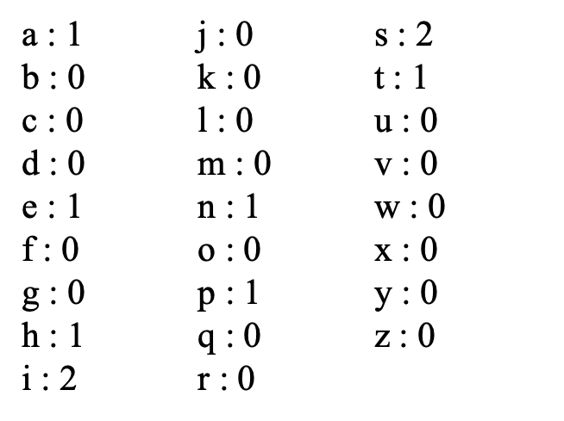
Exercise
Counting Characters
Write a program which counts and reports the number of each alphabetical letter. Ignore the case of characters.
Input
A sentence in English is given in several lines.
Output
Prints the number of alphabetical letters in the following format:
a : The number of 'a'
b : The number of 'b'
c : The number of 'c'
.
.
z : The number of 'z'
Constraints
The number of characters in the sentence < 1200
Sample Input
This is a pen.
Sample Output

Slide 17
Exercise
Toggling Cases
Write a program which converts uppercase/lowercase letters to lowercase/uppercase for a given string.
Input
A string is given in a line.
Output
Print the converted string in a line. Note that you do not need to convert any characters other than alphabetical letters.
Constraints
The length of the input string < 1200
Sample Input
fAIR, LATER, OCCASIONALLY CLOUDY.
Sample Output
Fair, later, occasionally cloudy.

Slide 18
Exercise
Card Game
Taro and Hanako are playing card games. They have n cards each, and they compete n turns. At each turn Taro and Hanako respectively puts out a card. The name of the animal consisting of alphabetical letters is written on each card, and the bigger one in lexicographical order becomes the winner of that turn. The winner obtains 3 points. In the case of a draw, they obtain 1 point each.
Write a program which reads a sequence of cards Taro and Hanako have and reports the final scores of the game.
Input
In the first line, the number of cards n is given. In the following n lines, the cards for n turns are given respectively. For each line, the first string represents the Taro's card and the second one represents Hanako's card.

Slide 19
Exercise
Constraints
n ≤ 1000
The length of the string ≤ 100
Output
Print the final scores of Taro and Hanako respectively. Put a single space character between them.
Sample Input
3
cat dog
fish fish
lion tiger
Sample Output
1 7

Slide 20

Exercise
Ring
Write a program which finds a pattern p
in a ring shaped text s.
Input
In the first line, the text s is given. In the second line, the pattern pis given.
Output
If p is in s, print Yes in a line, otherwise No.
Constraints
1≤length of p≤ length of s≤100
s and p consists of lower-case letters
Sample Input 2
vanceknowledgetoad
advanced
Sample Output 2
No
Sample Input 1
vanceknowledgetoad
advance
Sample Output 1
Yes

Slide 21
Exercise
Finding a Word
Write a program which reads a word W and a text T, and prints the number of word W which appears in text T. T consists of string Ti separated by space characters and newlines. Count the number of Ti which equals to W. The word and text are case insensitive.
Constraints
The length of W ≤ 10
W consists of lower case letters
The length of T in a line ≤ 1000
Input
In the first line, the word W is given. In the following lines, the text T is given separated by space characters and newlines.
"END_OF_TEXT" indicates the end of the text.
Output
Print the number of W in the text.
Sample Input
computer
Nurtures computer scientists and highly-skilled computer engineers
who will create and exploit "knowledge" for the new era.
Provides an outstanding computer environment.
END_OF_TEXT
Sample Output
3

